Slide 1

DATABASE INTERACTIONS FOR BALTIMORE CITY COMMUNITY COLLEGE
CHRISTIAN SAULS, MATT CLARK, JACOB DELLA, DALTON BROWN

Slide 2
INTRODUCTION
Baltimore City Community College desires a database and an application to display specific queries and information.
Their departments heavily rely on paper and manual labor to store information on day-to-day functions and generate reports. This can take days and is far from optimal.
Due to the departments decentralized management the backlog of searching and finding records on visitors, students and staff becomes extremely laborious.
We worked together with BCCC to develop and design an ERD, schema and associated application.

Slide 3
USER REQUIREMENTS – Expected Queries
List the names of the courses offered by a specific program.
List what courses are offered in a specific department during a specific semester.
List the first and last names of staff that teach a course in a specific program.
List the first and last names of staff that are also an advisor.
List the first and last names of students who has a specific staff member as an advisor.
Retrieve how many students withdrew/dropped a specific course during a specific semester.
Generate a list of professors who have taught at Baltimore City Community College for more than or equal to five years as of a specific semester.
List all of the first and last names of students enrolled in a specific program who are female.
Find the name of the student who has a specific ID no.
List the grade records all of the courses during a specific semester for a particular student.

Slide 4
USER REQUIREMENTS – Application Requirements
Provide a usable GUI to make usage easier
Provide faster querying and report generation.
Provide meaningful, easy to view reports.
Allow the program to be expanded upon in the future based on the needs of the customer
Allow the user to execute queries if needed
Allow user to perform all expected queries in a GUI environment

Slide 5
DATA MODEL REQUIREMENTS
Allow user to update all tables.
Allow user to access specific information for students, staff, courses, etc.
Allow user to generate a list of the number of students currently assigned under a specific department.
Allow user to generate a list of staff assigned to a specific course.
Allow user to generate a list of courses offered by a program during a specific semester.
Allow user to retrieve grade records for a specific course.
Allow user to retrieve grade records for each student.
Allow user to retrieve a list of visitors on a specific day.
Allow user to separate information according to identification status (student, staff, or visitor).
Allow user to verify all students have an advisor.

Slide 6
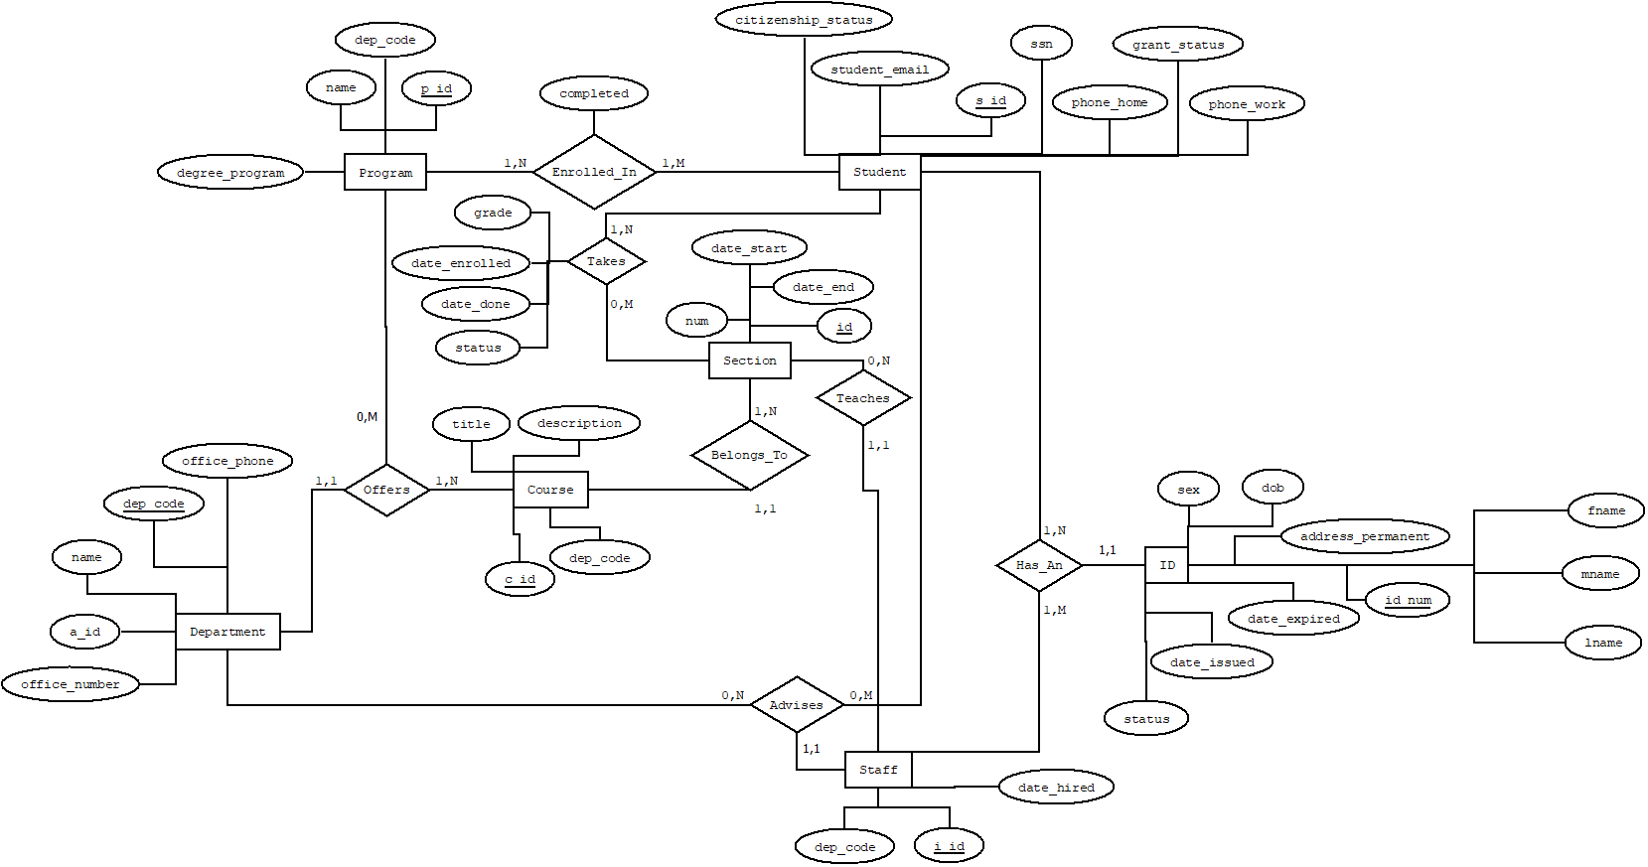
DATA MODEL – ERD

Slide 7
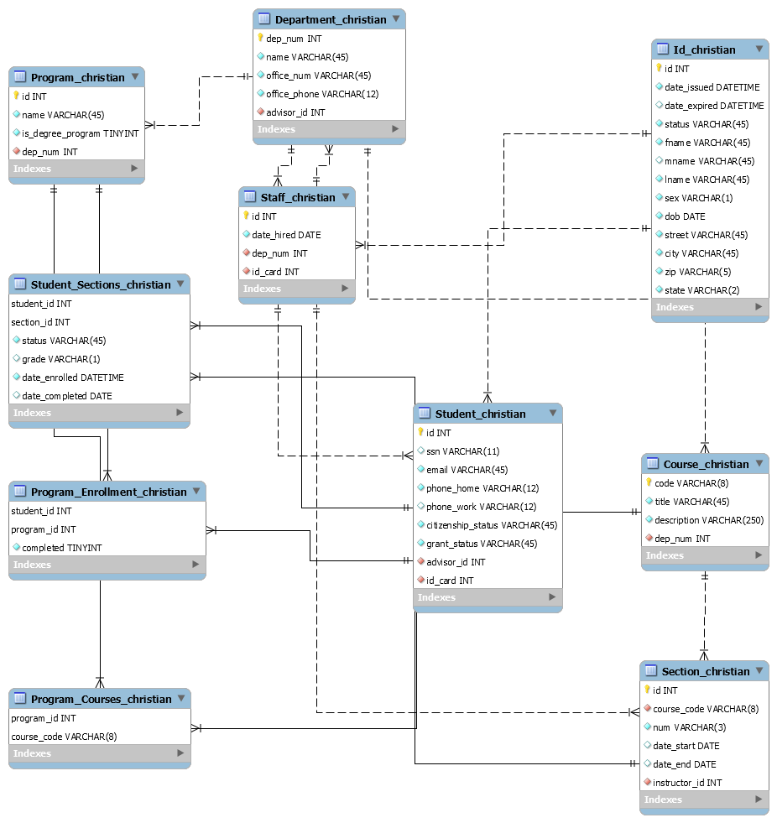
DATA MODEL – SCHEMA

Slide 8
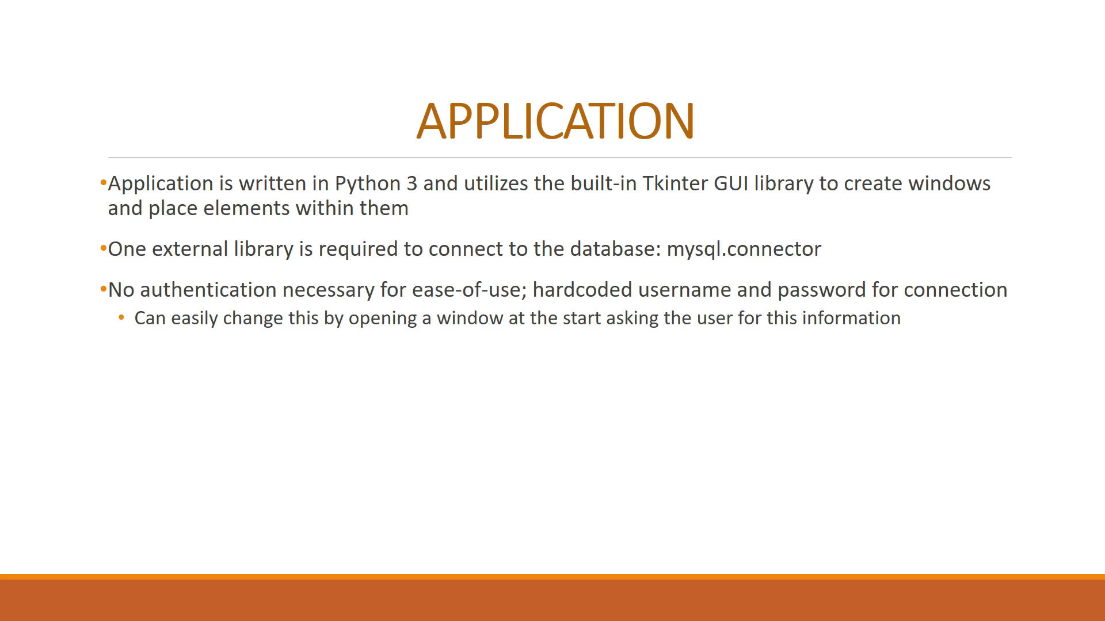
APPLICATION

Slide 9
APPLICATION
Application is written in Python 3 and utilizes the built-in Tkinter GUI library to create windows and place elements within them
One external library is required to connect to the database: mysql.connector
No authentication necessary for ease-of-use; hardcoded username and password for connection
Can easily change this by opening a window at the start asking the user for this information

Slide 10
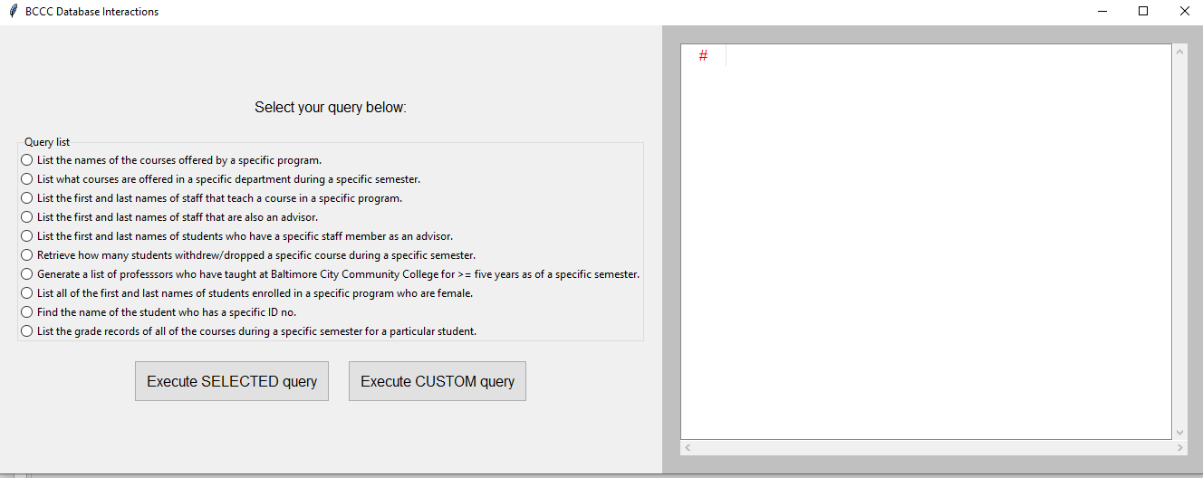
APPLICATION

Slide 11
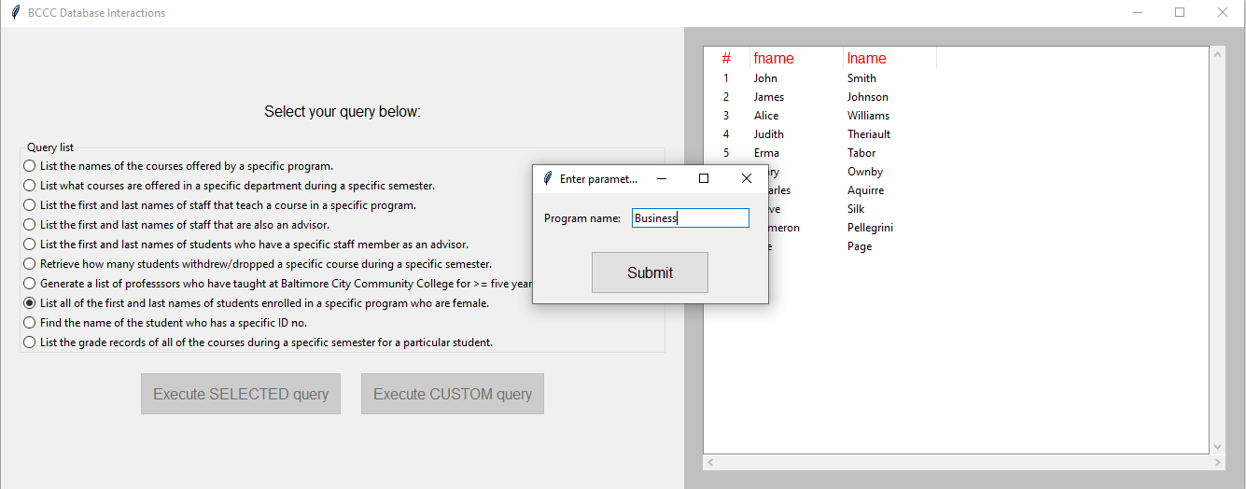
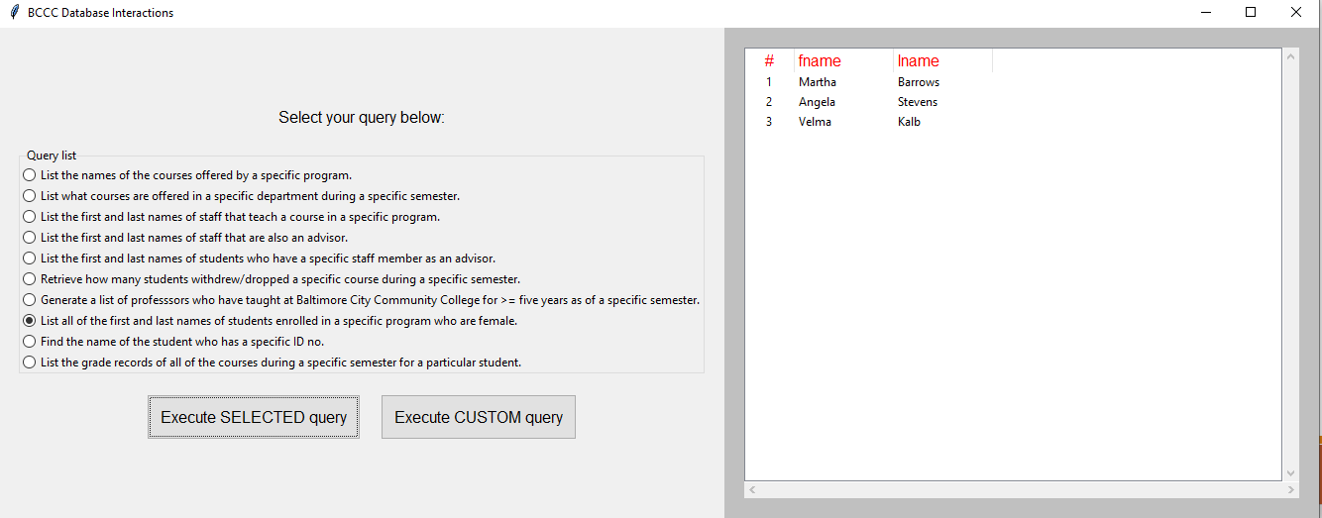
APPLICATION
Application is designed to be very simple to use
Simply click a query in the query list, click the execute button, and a window will pop up prompting the user for the parameters required for that query
After parameters are entered, hitting “Submit” will execute the query
Results neatly placed into the table

Slide 12
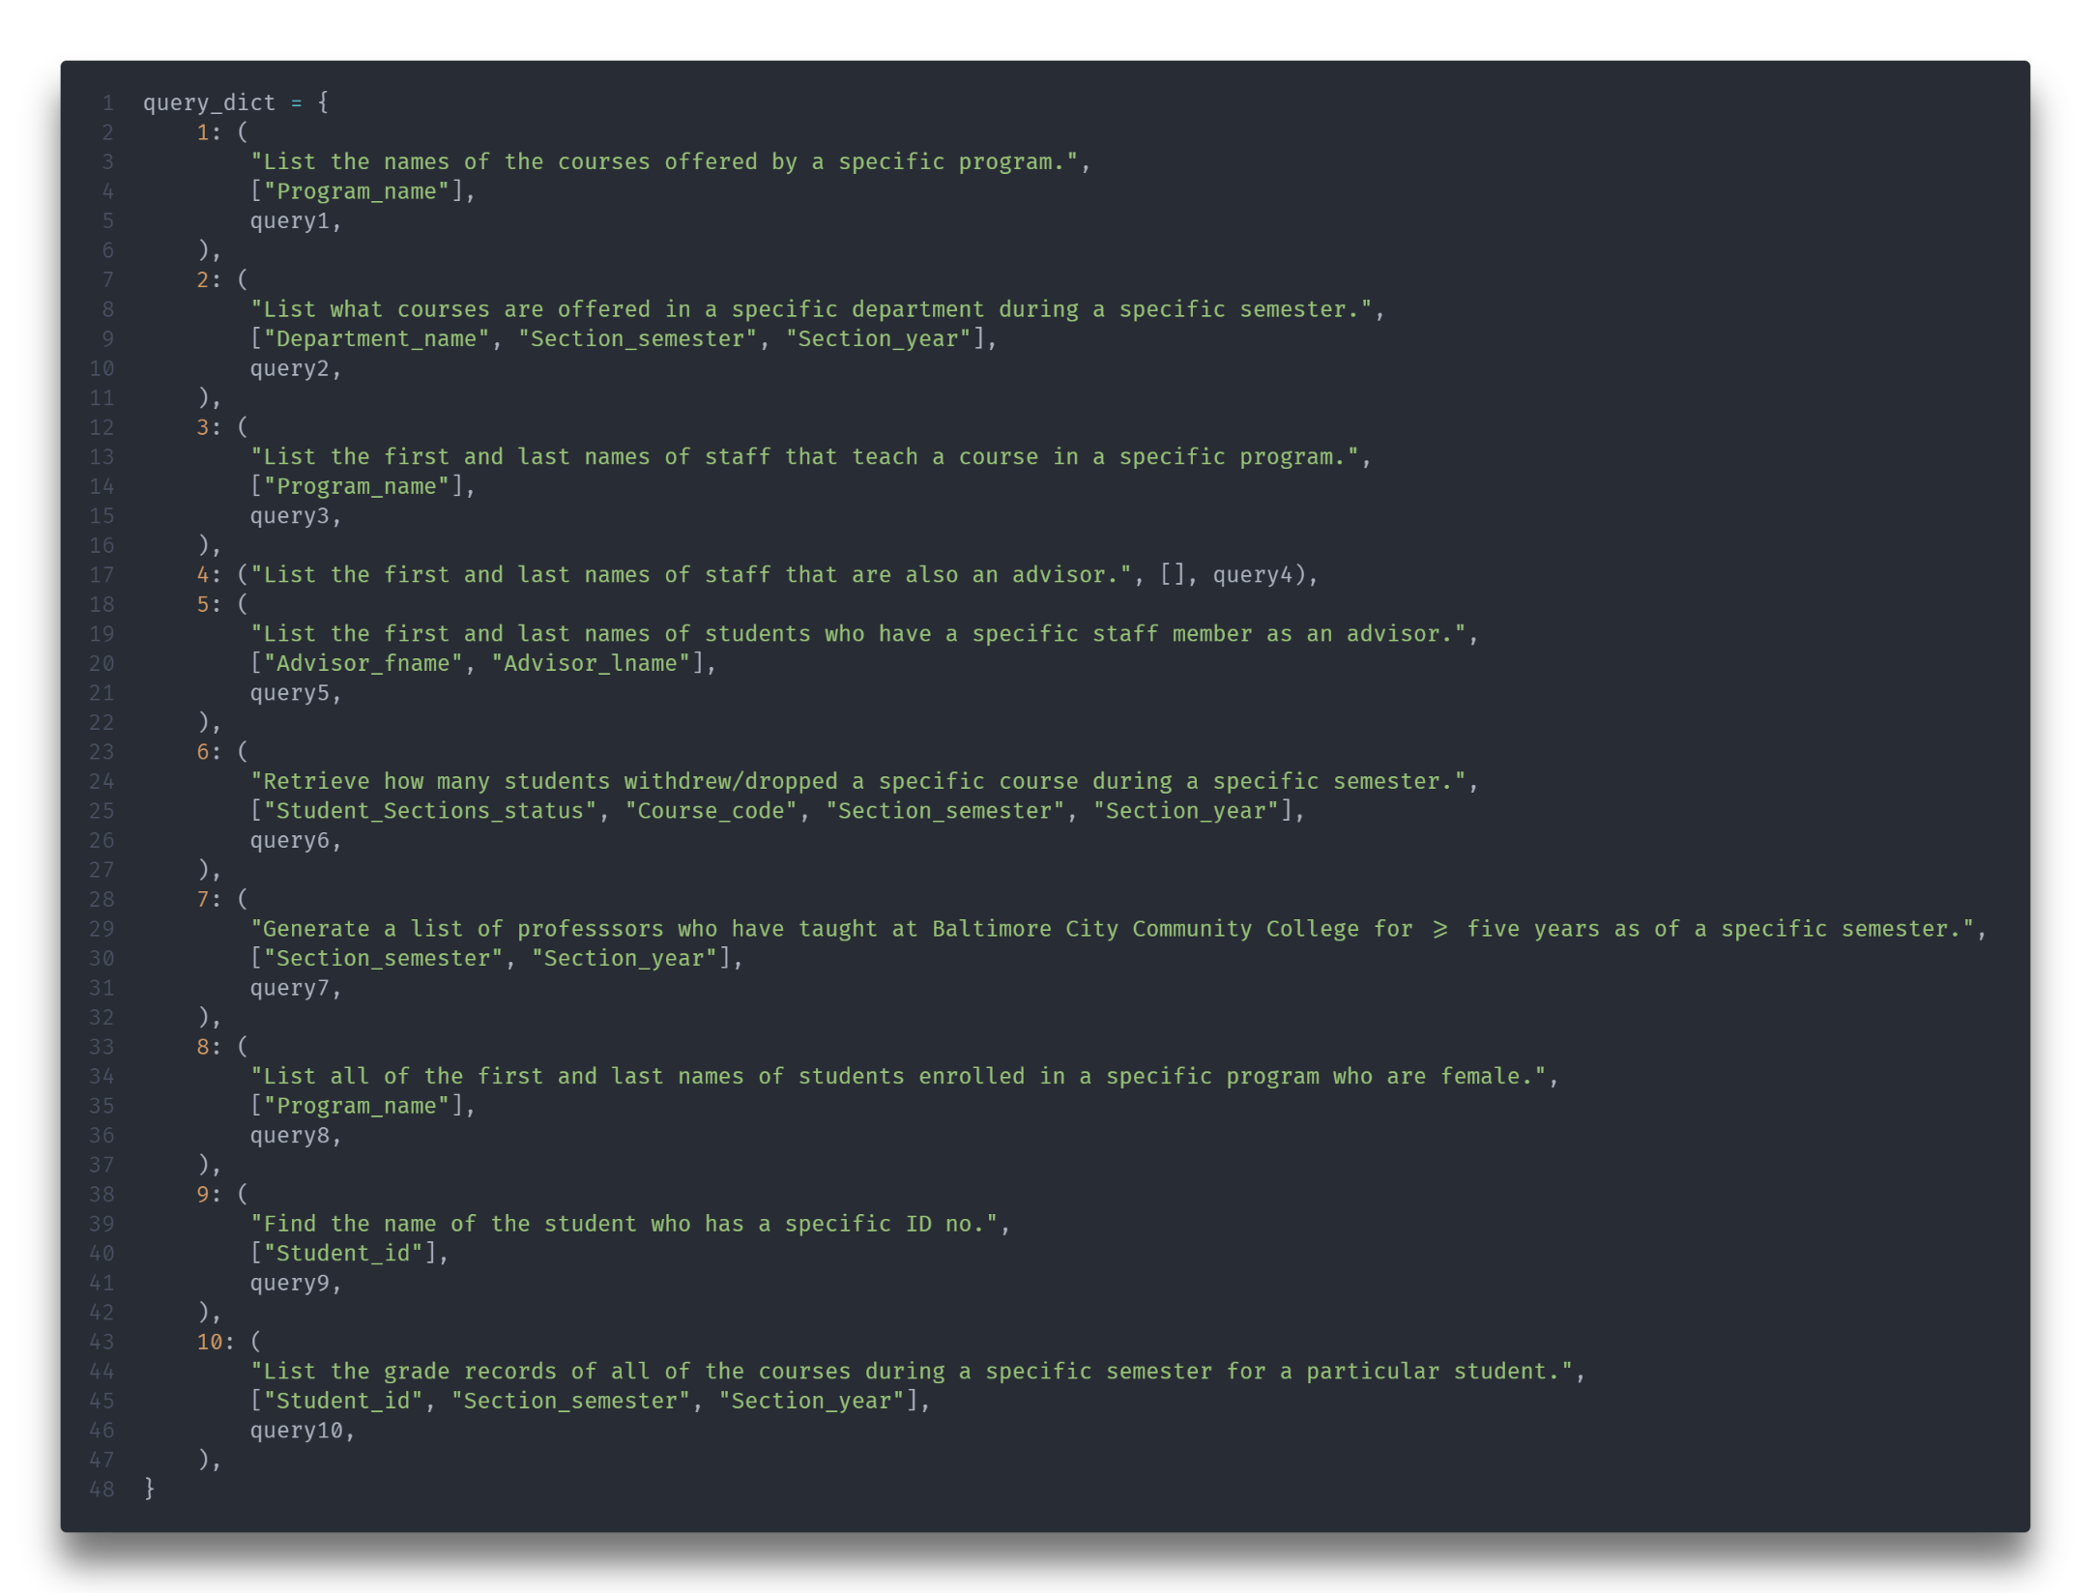
IMPLEMENTATION DETAILS
Python 3 script
Connects to the database
Outputs debugging information to the console
Uses the Tkinter library for our GUI
Dynamically generates all popup windows and parameters with their entry boxes
Dynamically executes queries based on the user’s option via a dictionary containing the necessary information for each query
Extremely extensible and maintainable

Slide 13
LIVE DEMO

Slide 14
Thank you Questions?

